Slide 1
DSP3 Project 3: Interstellar A Feedback Delay Network Reverb
A presentation by Nathan Erthal

Slide 2
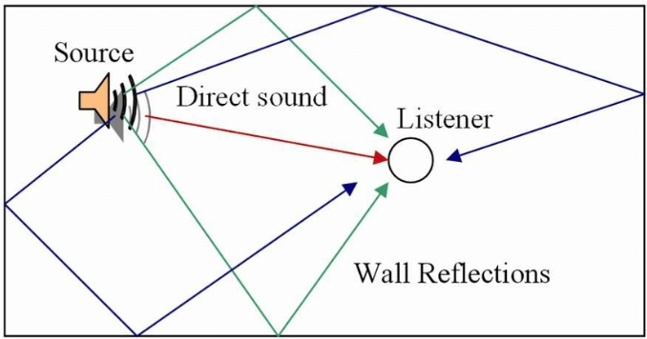
DSP3 Project 3: FDN Reverb
Area of Exploration:
Digital recreation of reverb
Reverb is created when numerous reflections of a sound around a space build up and decay as the sound is absorbed by the surfaces of objects in the space.
These reflections of sound waves we hear are what we call reverb.

Slide 3
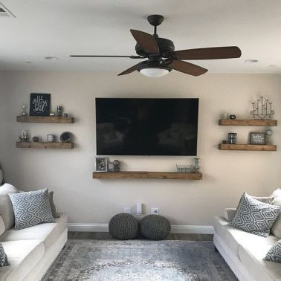
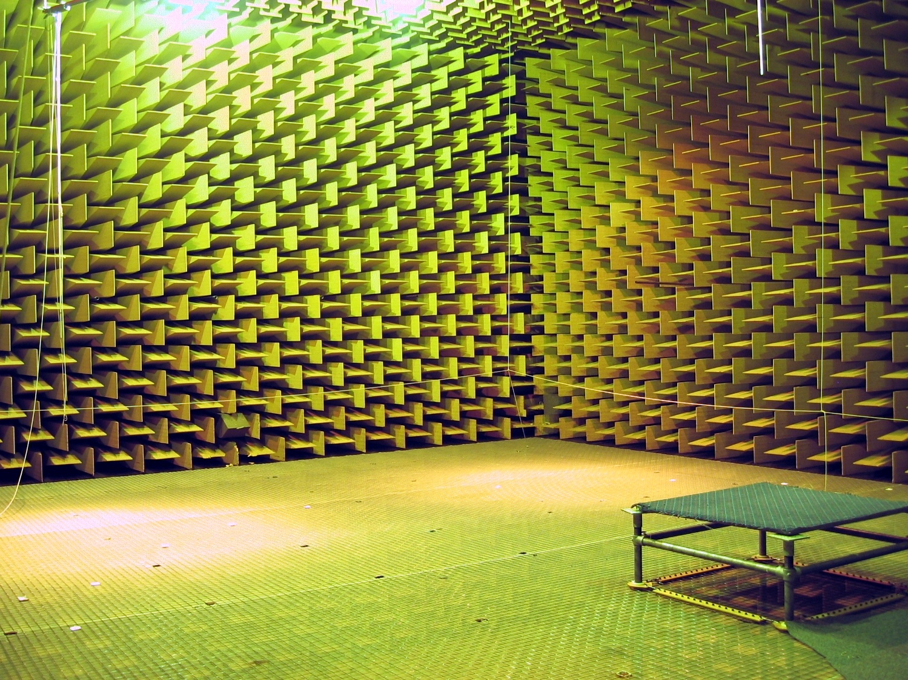


DSP3 Project 3: FDN Reverb
Digital reverbs sound good due to the illusion of being inside of a space, which is naturally how we hear sounds in our every-day environments.

Slide 4
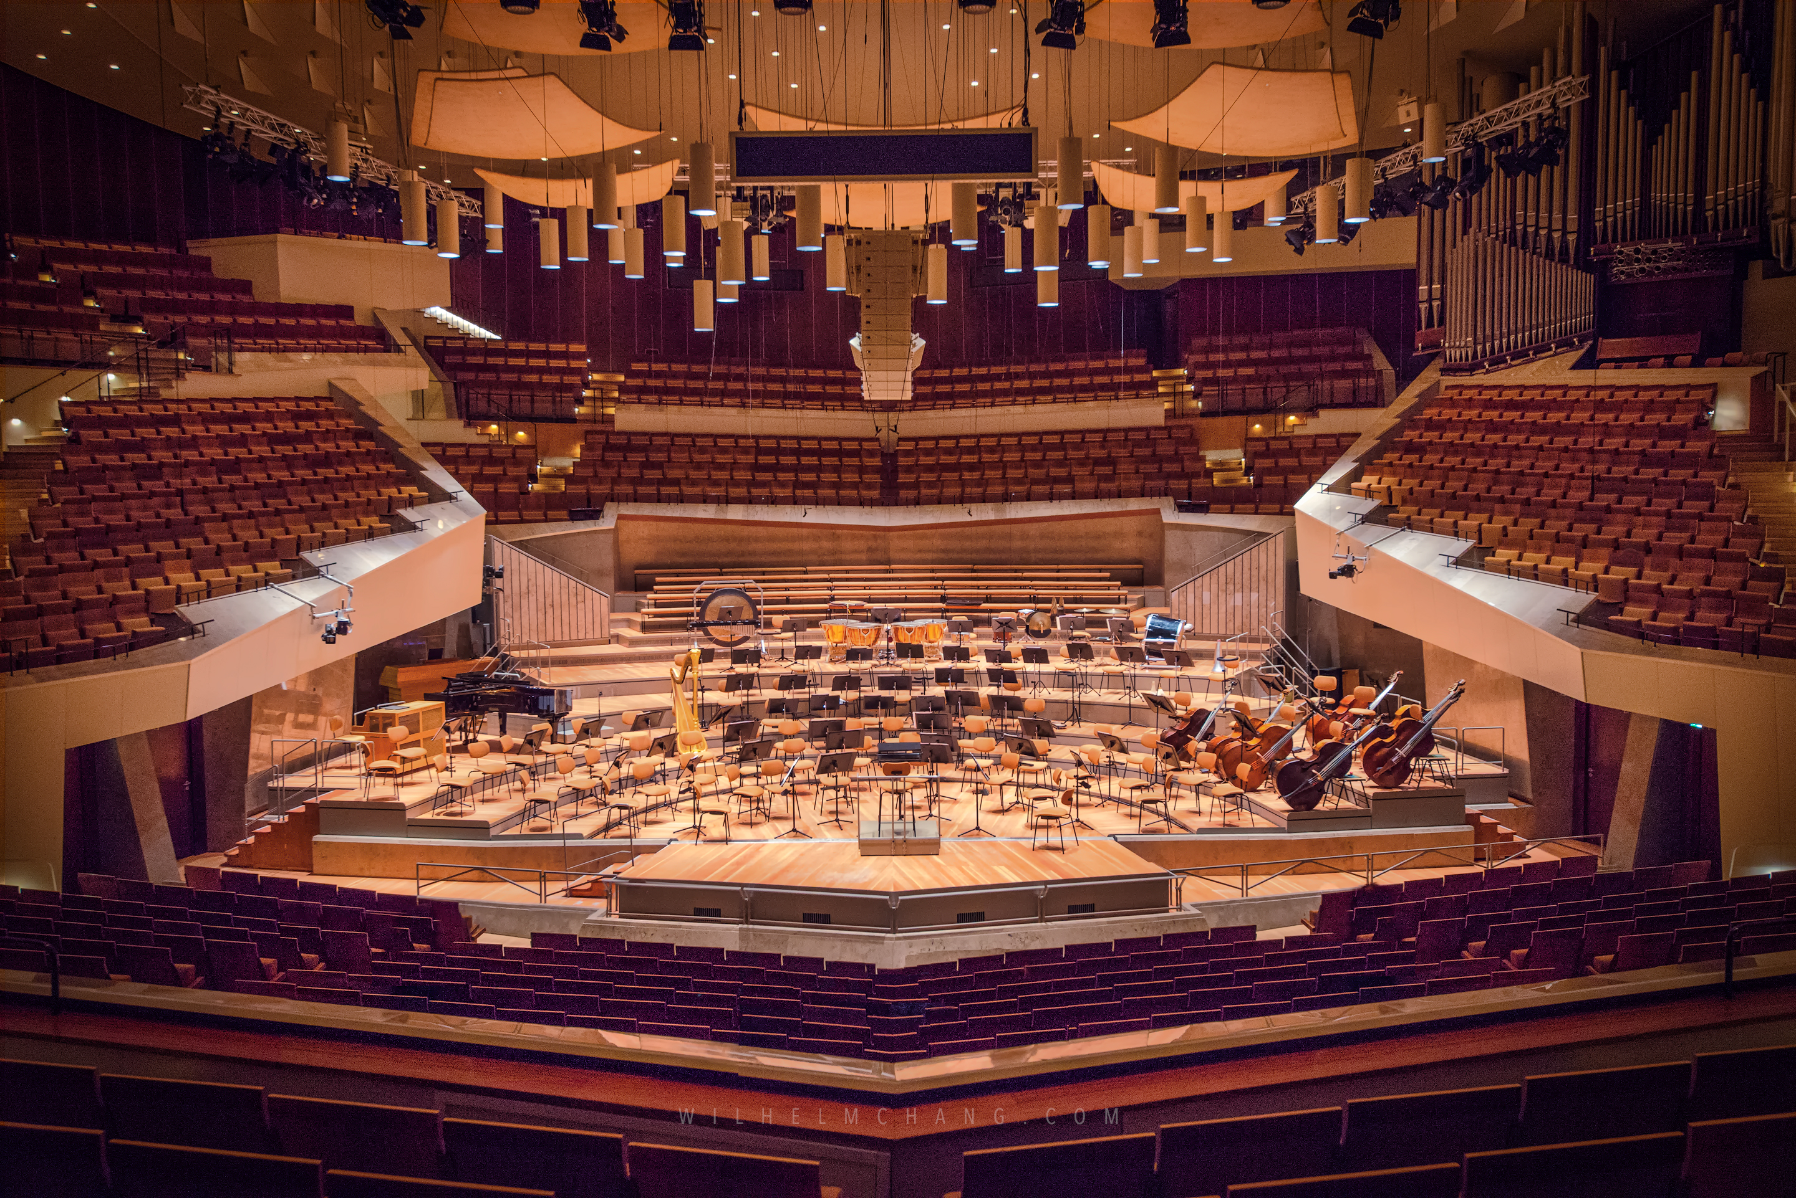
DSP3 Project 3: FDN Reverb
Longer and larger reverbs in particular, have been known to sound more pleasing as they create more depth and space for music to travel

Slide 5
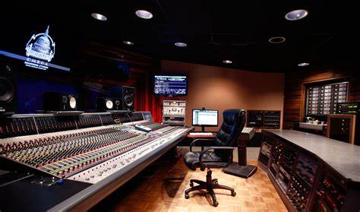
DSP3 Project 3: FDN Reverb
In music production and audio mixing, reverb helps to create more space and depth in the mix, also helps to create a more immersive and realistic experience

Slide 6
DSP3 Project 3: FDN Reverb
So how can we create a digital reverb effect ?

Slide 7
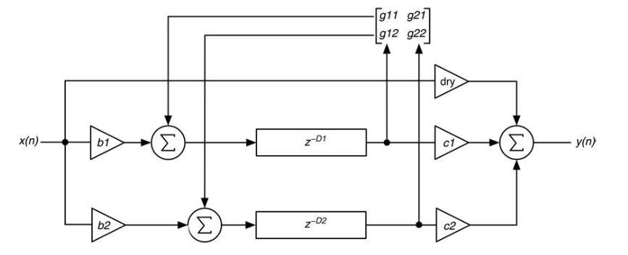
DSP3 Project 3: FDN Reverb
Tools for execution:
As the name suggests, a feedback delay network is composed of several delay lines each set to a different delay time
Feedback matrix
What helps to create the effect is feeding back the output from each delay line into itself and into the other delay lines.
Delay-line
Delay-line

Slide 8
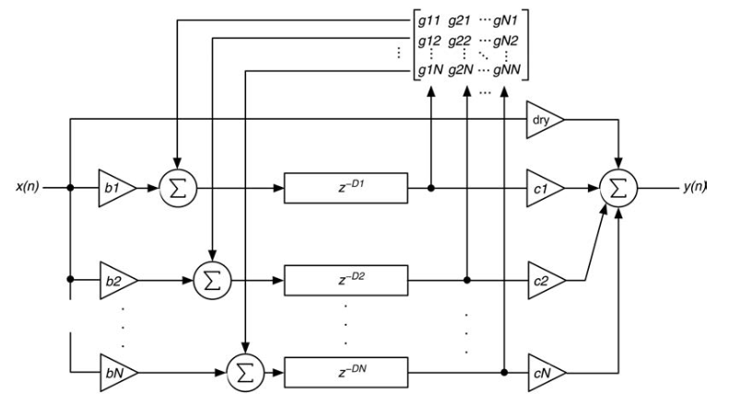
DSP3 Project 3: FDN Reverb
Feedback Delay Network (FDN)
Using more delay lines can help to create a thicker and more realistic reverb:

Slide 9
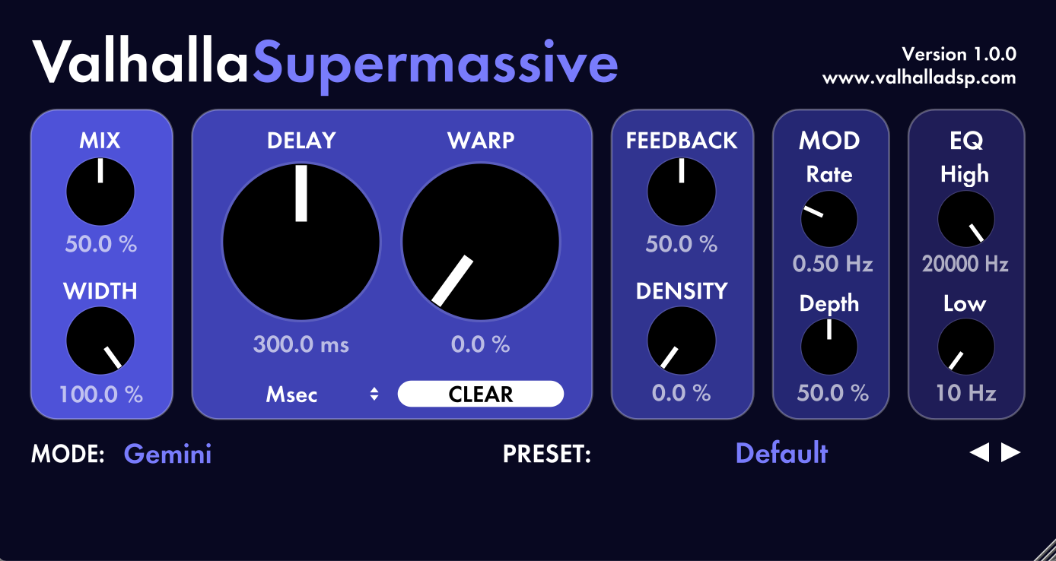
DSP3 Project 3: FDN Reverb
This project takes great inspiration from Valhalla DSP’s Supermassive delay/reverb effect:
So we will try to implement our own version of some of these knobs…

Slide 10
DSP3 Project 3: FDN Reverb
Feedback and Density
We will use 8 Delay lines for each channel for a total of 16 delay lines.
This would give us a 16 x 16 feedback matrix.
It’s easy for these matrixes to become unstable so we must think of a way for our coefficients to work together creating a smooth reverberation that also doesn’t sound ringy…

Slide 11
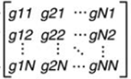
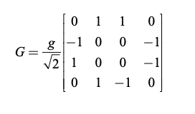
DSP3 Project 3: FDN Reverb
Feedback and Density
An example representation of coefficients for a 4 x 4 feedback matrix, where g is the value from our feedback parameter:

Slide 12
DSP3 Project 3: FDN Reverb
Feedback and Density
Our feedback matrix will be a little different… Not only because we have more delays, but also because we’d like to include a feedback feature as such as from a normal delay
1
0
0
0
0
1
0
0
0
0
1
0
0
0
0
1

Slide 13
DSP3 Project 3: FDN Reverb
Feedback and Density
For our version of the density knob, we can have feedback from delay lines going to other ones long as those receiving delay lines don’t recieve feedback from the original “sending” ones
0
0
0
0
0
0
0
0
1
1
0
0
Here, feedback from delay lines 1 and 2 go into every delay line that’s not themselves or each other
1
1
0
0
(Scaled down to 4x4)

Slide 14
DSP3 Project 3: FDN Reverb
Feedback and Density
Where feedback is the coefficient for delay feedback into itself and density is the coefficient for the delay feedback into another delay.
Leaving our final matrix like this:
feedback knob coefficients and blue
density knob coefficients in red
1
0
0
0
0
0
0
0
0
1
0
0
0
0
0
0
-1
-1
1
0
0
0
0
0
-1
-1
0
1
0
0
0
0
1
0
0
0
0
1
0
0
-1
-1
0
0
1
0
0
0
-1
-1
0
0
0
1
0
0
-1
-1
1
0
-1
-1
0
1
-1
-1
0
0
0
0
1
0
-1
-1
0
0
0
0
0
1
(Scaled down to 4x4)
(Scaled down to 8x8)

Slide 15
DSP3 Project 3: FDN Reverb
Delay & Warp
Next, to determine the delay settings of each delay line, we use our delay knob and warp knob
The delay knob will determine the delay time of the longest delay line.
The warp knob will determine how much earlier the delay of the other delay lines will be in comparison to the longest one.

Slide 16
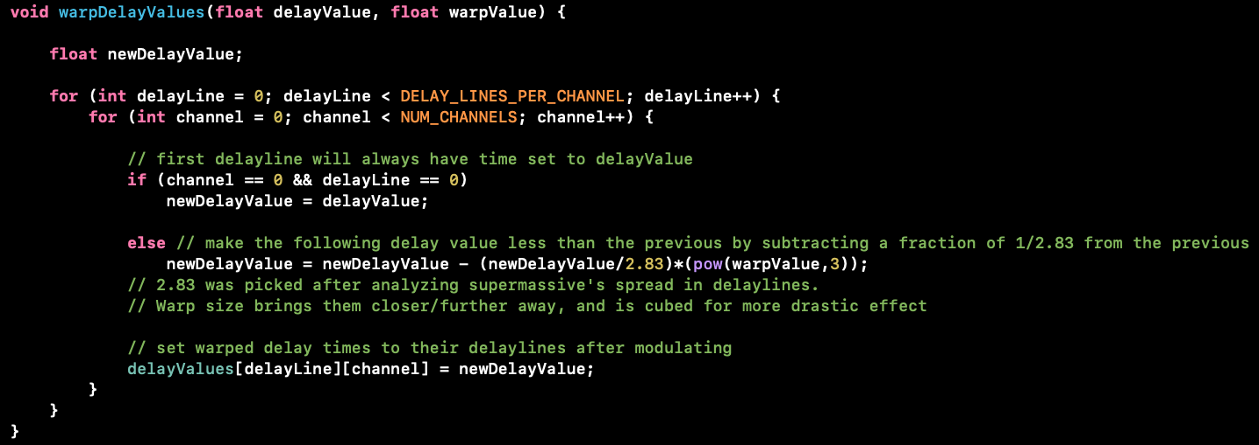
DSP3 Project 3: FDN Reverb
Delay & Warp

Slide 17
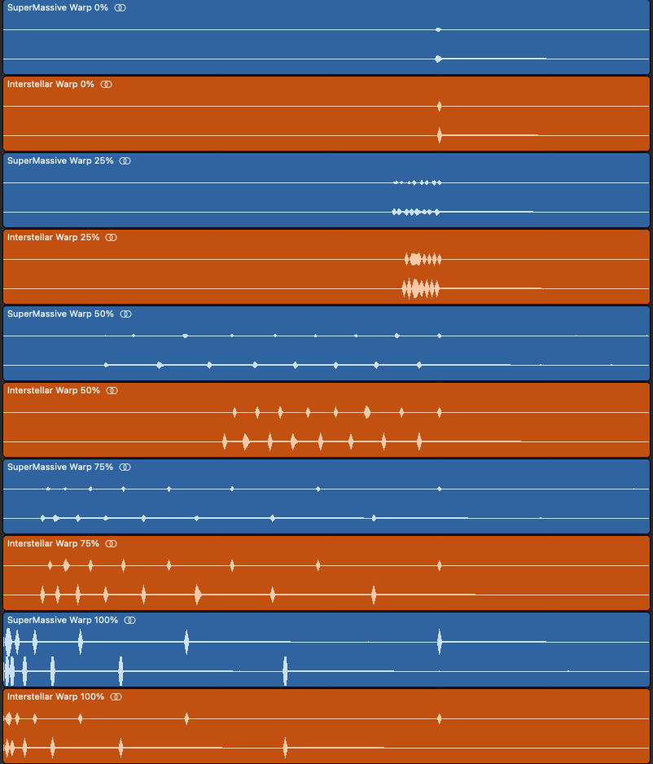
DSP3 Project 3: FDN Reverb
Comparison of Warp settings between Supermassive and our Interstellar:
(1s delay, 100% mix, 0 feedback/density/modulation)

Slide 18
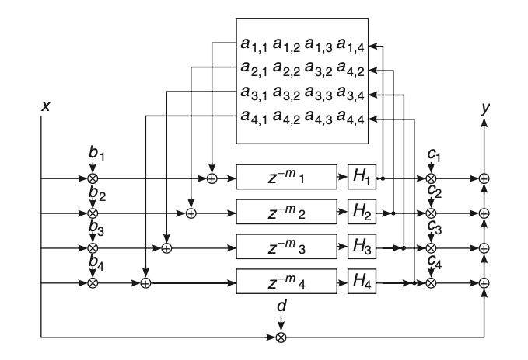
DSP3 Project 3: FDN Reverb
Low-pass / High-pass Filters
Frequency response in rooms and spaces are never a flat, so we need to implement filters:
To make our reverb effect more realistic, we place filters at the output of each delay line, before the feedback, creating a more filtered output for each fed-back iteration of the same signal:

Slide 19
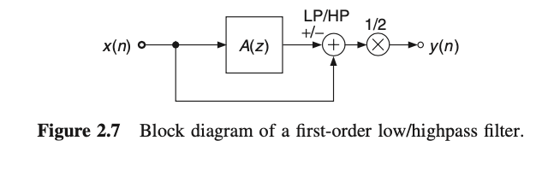
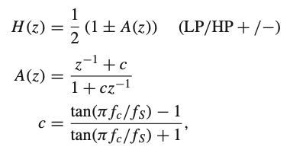
DSP3 Project 3: FDN Reverb
Low-pass / High-pass Filters
We implement our filters with a very gentle/gradual slope so that the signal gets only slightly more filtered each iteration, behaving like a cascading filter.
For this case, a first-order low/highpass filter works:

Slide 20
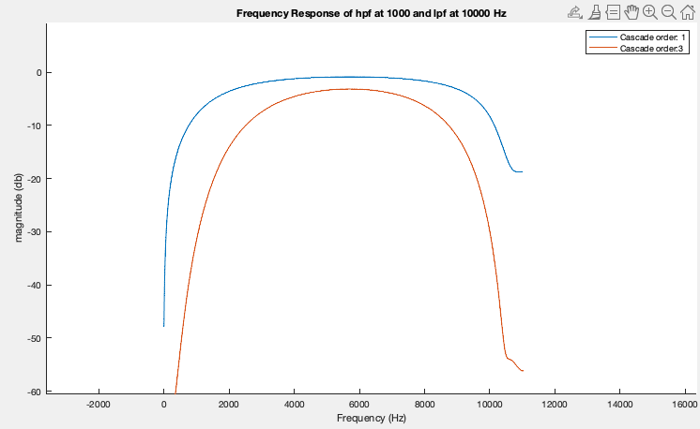
DSP3 Project 3: FDN Reverb
Low-pass / High-pass Filters

Slide 21
DSP3 Project 3: FDN Reverb
Diffusion
Diffusion provides high-density echoes in the late impulse response of the reverberator
This seems to be the effect that Supermassive’s density knob actually seems to be doing.
In our implementation, we’ll call this effect the diffusion for the reverb as another way of increasing the density of our sound.

Slide 22
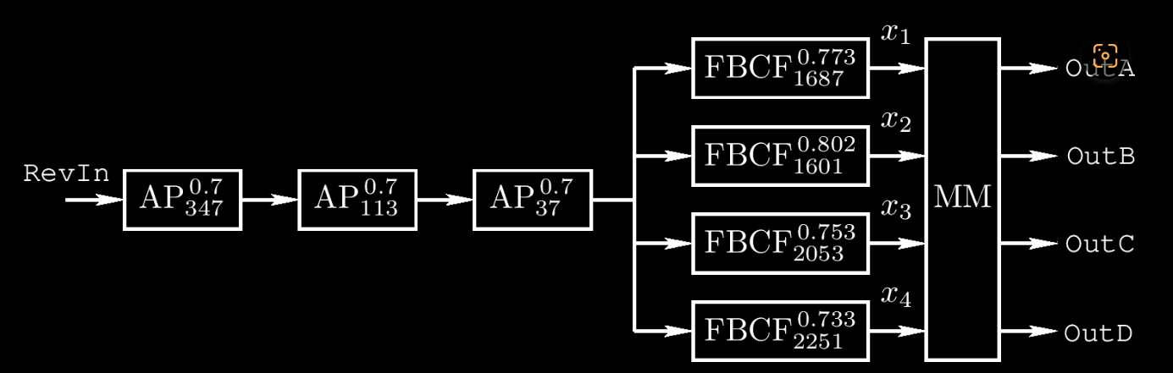
DSP3 Project 3: FDN Reverb
Diffusion
That is achieved with all pass filters before our delay lines as shown in this example of the classic design of the Schroeder Reverberator:

Slide 23
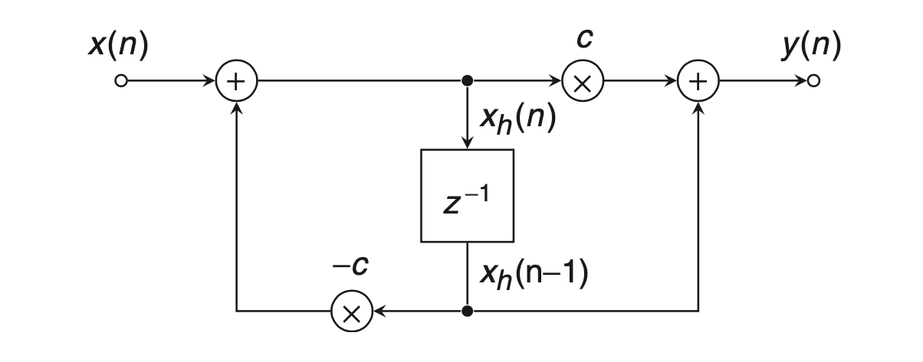
DSP3 Project 3: FDN Reverb
Block Diagram for a first order all pass filter:

Slide 24
User feedback:
Stefan:
Great GUI
Everything but labels seem a bit tiny
Nonlinearities in there might be good
Allow for steepness selection in high and low cut
Presets could be added?
Kartik:
Cool sounding delay effects
Control of reverb could be better (time parameters doesn’t perfectly represent a reverb parameter
Sounds like a reverb but doesn’t feel like one when using, feels more like a delay plugin
Saty:
The ultimate plugin for pads.
Love the GUI, Black and Orange is always great.
Maybe have low-shelving and high-shelving filters instead of a high cut or low cut, so that you can have better control over the gain of the bands.

Slide 25
Future plans:
Optimize CPU usage
Volume normalization
Presets
Find optimal settings and structure for all-pass filters
Low-cut / high-cut filters

